Slide 1
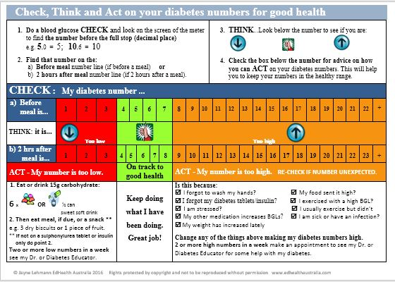
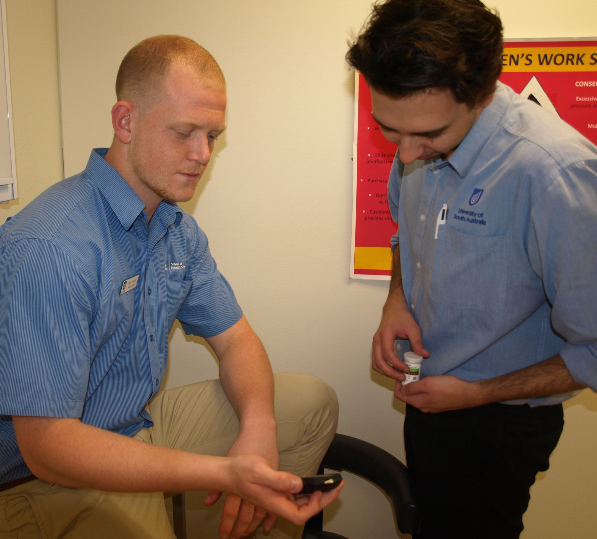
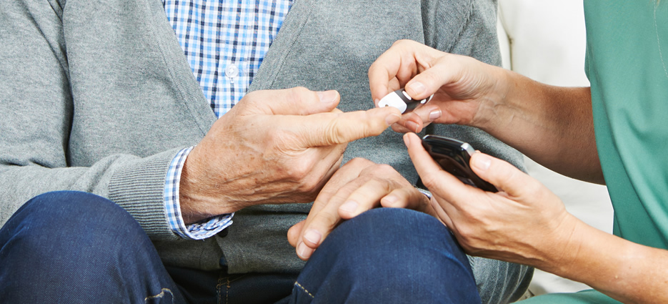

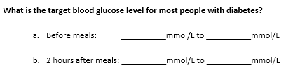


Impact of the Check, Think and Act Resource on Undergraduate Podiatry Students’ Learning
J. Lehmann ^{1.} S. Jones ^{2.}
1. EdHealth Australia, Highgate, South Australia, Australia. 2. School of Health Sciences, University of South Australia.
Introduction
The Check, Think and Act Resource
Discussion
The Check, Think and Act paper-based resource was designed to educate and support people with type 1 and type 2 diabetes to understand and act on their capillary blood glucose levels (BGLs) when self blood glucose monitoring.
Anecdotally the resource has been well accepted by people with diabetes and improvements observed in their ability to use their blood glucose monitoring in a more proactive approach.
While not previously used in student teaching, it was felt the resource could be an effective education method to educate podiatry undergraduate students in the role of blood glucose monitoring and meaning of blood glucose levels in diabetes care.
This study conducted an initial validation of the Check, Think and Act resource to establish the robustness of the resource in achieving its purpose and its potential use as an effective teaching tool within podiatry undergraduate health curriculums.
Jayne Lehmann, a South Australian Credentialled Diabetes Educator, created the Check, Think and Act resource to teach people with diabetes how to understand and act on their blood glucose levels. The aim was to decrease the time people with diabetes spent outside of their individualised target blood glucose range.
Created using a colour coded table with
two number-lines, low literacy text and
boxed information to address numbers
outside of the range, the resource
supports a structured approach to blood
glucose monitoring. Using an education
and empowerment based approach the
steps and simple phrasing encourage people to check their blood glucose level, think about the result and act on them to bring them back to target for good health and wellbeing.(Refer Figure 3.)
The Check Think and Act resource is designed to:
Educate and empower people to use a structured approach to monitoring by taking the emotion and burden out of blood glucose monitoring
Simplify the blood glucose level into a whole number without the need to round up or down; also decreases anxiety re reproducibility of levels (+/- 15% of actual result)
Use language that supports positive behaviours e.g. check not test
Increase understanding of the meaning of the number by simplifying definitions i.e. low = hypoglycaemia; healthy = on target; high = hyperglycaemia
Increase ability to act on issues within their control to change blood glucose levels
Know when to return to the doctor or diabetes educator for further review,
N.B. Target levels can be customised with a dark pen to border desired target numbers.
The resource is a cost effective education tool (1.) and handout (2.).
1. Print a colour A4 paper copy of the resource and laminate for an education tool to:
Simplify the process of teaching a person to understand blood glucose levels
Educate and support people to check their blood glucose levels, think about the result and act on the diabetes number for good health and wellbeing.
2. Print colour copies of the A4 paper copy of the resource and provide each person with diabetes with their own copy, after their education using the laminated copy. They are able to take this home to use as a ready reckoner to support action on blood glucose levels.
The author uses the resource with people with type 1 and type 2 diabetes, health professionals and students. It has not previously been formally validated.
Due to the higher risk of neuro-vascular complications in the lower legs and feet of people with diabetes^{1.} podiatrists play an important role in the care of people with diabetes. Ensuring their competence in understanding a patient’s blood glucose levels, or that obtained using the blood glucose meter in a clinical environment, requires inclusion of the interpretation of blood glucose levels in the undergraduate podiatry course of future podiatrists.
The Check, Think and Act resource was used as an education strategy to teach third year podiatry students at the University of SA (Refer Figure 4) how to interpret blood glucose levels in people with diabetes. Students were able to use the resource to answer the post session questions if they wished to do so, replicating the use of such a resource in clinical practice.
Analysis of the pre and post education session responses showed a significant improvement (p value < 0.001) in the knowledge of the third year podiatry students when asked to state the target levels for most people with diabetes before and 2 hours after meals. Pre test, one out of thirty-five students identified the correct levels, increasing to thirty-two out of thirty-five post test.
Capillary blood glucose monitoring is conducted by people with diabetes to assess their current glycaemic management and self care practices. The Check, Think and Act resource supported the podiatry students to gain a better understanding of capillary blood glucose monitoring and the interpretation of blood glucose levels in people with diabetes.
While this study reviewed the Check, Think and Act as an education resource for the students, it has the potential to also be used to educate people with diabetes about their target blood glucose levels within podiatry practice. This would be helpful if treating a person with diabetes who requires improved glycaemia to support wound healing and resolution of infection.
A comprehensive approach to the assessment, treatment and evaluation of podiatry care includes the assessment of blood glucose levels. Identification of hyperglycaemia, implicated in increasing the risk of wound infection and poor healing, supports a referral to their medical practitioner or Credentialled Diabetes Educator for review and advice.
The Check, Think and Act resource had a significant impact on the understanding of blood glucose levels of podiatry undergraduate students. Their self reported rating of their knowledge of diabetes rose post test (5.46/10 to 7.61/10) Identification of effective education resources are important for time efficient teaching. Review of the ability of this resource to educate other undergraduate students in health focussed courses such as medicine, nursing, dietetics, exercise physiology and psychology is required. Formal review of its use with people with type 1 and type 2 diabetes would be beneficial.
Figure 3: Check, Think and Act resource
Aim
Assess the effectiveness of the Check, Think and Act paper based resource to teach third year podiatry students how to interpret BGLs.
Method
Figure 4: University of South Australia undergraduate podiatry students reviewing blood
glucose level during clinical placement.
Students commencing their third year of the Bachelor of Podiatry program at the University of South Australia attended a 1.5 hour tutorial on diabetes and blood glucose monitoring in February 2016 as part of their pre-clinical teaching block. The Check, Think and Act resource was used to teach the students the interpretation of blood glucose levels in people with diabetes.
This study was undertaken in three parts:
Part 1: Pre teaching knowledge was assessed using a 3-item non-validated
questionnaire comprising yes/no; Likert scale (1 = Poor – 10 =
Excellent) (Refer Figure 1) and short answer questions
(Refer Figure 2)
Part 2: Presentation to the students, by a Credentialled Diabetes Educator,
on the use of the Check, Think and Act resource in podiatry clinical
settings.
Part 3: Post teaching students completed a 15-item non-validated questionnaire
that included open-ended and Likert scale questions.
Responses were compiled onto an Excel spreadsheet for statistical analysis using a Student's paired t-test.
Results
Thirty-six students completed both pre-teaching and post-teaching session questionnaires. One student response was incomplete and subsequently withdrawn from the sample (n=35). Results were collated and compiled using an Excel spreadsheet.
Participants were asked in the pre-teaching questionnaire ”Do you have diabetes or any experience in diabetes care?” Three of thirty-five (8.6%) participants responded yes.
The targets identified as ‘correct’ in evaluating the questionnaire were:
Before meals 4 – 7 mmol/L
2 hrs after meals 4 – 8 mmol/L
Analysis of the results using Student's paired t-test, identified a p value < 0.001 for the question asking students to state the target blood glucose levels for most people with diabetes before and 2 hours after results (Q.6) Refer Table 1.
Figure 1: Likert scale used in student questionnaire
Table 1: Podiatry student pre and post teaching responses (Check, Think
and Act resource)
Conclusion
Figure 2: Short answer question to identify target levels for pre and 2
hours post meal blood glucose monitoring.
Questions | Results (n=35)
Q. 2 How do you rate your current understanding of blood glucose levels in people with diabetes? | Pre session: (Av.) 5.46/10 Range 4-9 on Likert scale
 | Post session: (Av.) 7.61/10 Range 5-10 on Likert scale
Q. 6 What is the target blood glucose level for most people with diabetes before and 2 hours after meals? | Pre session: 1/35 participants
 | Post session: 32/35 participants Pre vs. post : p = < 0.001
The Check, Think and Act resource was proven to be statistically significant in its ability to effectively teach third year podiatry students how to interpret blood glucose levels in managing diabetes. The resource is likely to be an effective education strategy for students in other undergraduate podiatry programmes across Australia as well as a patient education resource in their clinical work.
Further validation of the Check, Think and Act resource is required including the longer term retention of knowledge of this cohort of 3rd year podiatry students. Validation of resource use with people with diabetes, health professionals and other undergraduate health students is also required.
Student evaluation of the effectiveness of the Check, Think and Act resource to support their understanding of the use of blood glucose levels for the care of people with diabetes was undertaken. Refer Table 2.
Table 2: Third year Podiatry student evaluation of the effectiveness of the Check,
Think and Act resource
Reference
Question | Results (n=35)
Q. 11 … rating of the Check, Think and Act tool to support you in the understanding of blood glucose levels in people with diabetes? | 8.48/10 (Likert scale) Range 6-10 on Likert scale
Sumpio BE, Armstrong DG, Lavery LA, Andros G, SVS/APMA writing group
The role of interdisciplinary team approach in the management of the diabetic foot:
a joint statement from the Society for Vascular Surgery and the American Podiatric
Medical Association. J Vasc Surg. 2010 Jun;51(6):1504.
Acknowledgement: Copyright - Check, Think and Act resource 2016-Jayne Lehmann.
Not to be reproduced from this format.

